Slide 1
IN723 BGP Introduction
Packet types
Neighbor states
Attributes
Routing Table

Slide 2
Resources
Case Studies
http://www.cisco.com/c/en/us/support/docs/ip/border-gateway-protocol-bgp/26634-bgp-toc.html
Configuration Guide
http://www.cisco.com/c/en/us/td/docs/ios-xml/ios/iproute_bgp/configuration/15-mt/irg-15-mt-book.html
Command Reference
http://www.cisco.com/c/en/us/td/docs/ios-xml/ios/iproute_bgp/command/irg-cr-book.html
Notes:
Microsegmentation = split a larger collision domain into smaller ones in order to reduce collision probability

Slide 3
BGP Table
BGP keeps its own table for storing BGP information received from and sent to BGP neighbors.
This table is also known as the BGP table, BGP topology table, BGP topology database, BGP routing table, and the BGP forwarding database.
The router offers the best routes from the BGP table to the IP routing table.

Slide 4
BGP Tables
Neighbor table
List of BGP neighbors
BGP table (forwarding database)
List of all networks learned from each neighbor
Can contain multiple paths to destination networks
Contains BGP attributes for each path
The BGP table version ONLY increments when there is a change to a BGP best path
IP routing table
List of best paths to destination networks
Notes:
A router running BGP keeps its own tables to store BGP information that it receives from and sends to other routers, including a neighbor table, a BGP table (also called a forwarding database or topology database), and an IP routing table.
For BGP to establish an adjacency, you must configure it explicitly for each neighbor. BGP forms a TCP relationship with each of the configured neighbors and keeps track of the state of these relationships by periodically sending a BGP/TCP keepalive message.
The BGP sends BGP/TCP keepalives by default every 60 seconds.
After establishing an adjacency, the neighbors exchange the BGP routes that are in their IP routing table. Each router collects these routes from each neighbor that successfully establishes an adjacency and then places them in its BGP forwarding database. All routes that have been learned from each neighbor are placed into the BGP forwarding database. The best routes for each network are selected from the BGP forwarding database using the BGP route selection process and then offered to the IP routing table.
Each router compares the offered BGP routes to any other possible paths to those networks, and the best route, based on administrative distance, is installed in the IP routing table.
EBGP routes (BGP routes learned from an external autonomous system) have an administrative distance of 20. IBGP routes (BGP routes learned from within the autonomous system) have an administrative distance of 200.

Slide 5
BGP Message Types
There are four different BGP message types:
Open Message
Octets
16 | 2 | 1 | 1 | 2 | 2 | 4 | 1 | 7
Marker | Length | Type | Version | AS | Hold Time | BGP ID | Optional Length | Optional
Update Message
Octets
16 | 2 | 1 | 2 | Variable | 2 | Variable | Variable
Marker | Length | Type | Unfeasible Routes length | Withdrawn Routes | Attribute Length | Attributes | NLRI
Notification Message
Octets
16 | 2 | 1 | 1 | 1 | Variable
Marker | Length | Type | Error Code | Error Sub-code | Diagnostic Data
Keepalive Message
Octets
16 | 2 | 1
Marker | Length | Type
Notes:
Messages may be between 19 and 4096 bytes long.
All begin with the same 3 field header:
Marker field (16-bytes) - Used either to authenticate BGP messages or to detect loss of synchronization between two BGP peers
Length field (2-bytes) - Indicates the total BGP message length, including the header.
Type field (1 byte) - Corresponds to one of the four BGP message types.

Slide 6
Open Message
Once a TCP connection has been established, the Open message is sent and includes a set of parameters that have to be agreed upon before a full BGP adjacency can be established.
Once both BGP peers have agreed upon mutual capabilities, they can start exchanging routing information by means of BGP Update messages.
Open Message
Octets
16 | 2 | 1 | 1 | 2 | 2 | 4 | 1 | 7
Marker | Length | Type | Version | AS | Hold Time | BGP ID | Optional Length | Optional
Notes:
Version 4
Local AS number
Hold time
BGP router-id

Slide 7
Update Message
Update messages contain all the information BGP uses to construct a loop-free picture of the internetwork.
A BGP update message has information on one path only; multiple paths require multiple update messages.
All the attributes in the update message refer to that path, and the networks are those that can be reached through it.
An UPDATE message is used to advertise feasible routes that share common path attributes to a peer, or to withdraw multiple unfeasible routes from service
Update Message
Octets
16 | 2 | 1 | 2 | Variable | 2 | Variable | Variable
Marker | Length | Type | Unfeasible Routes Length | Withdrawn Routes | Attribute Length | Path Attributes | NLRI
Notes:
Path = prefixes sharing same attributes = at minimum AS-PATH
An UPDATE message is used to advertise feasible routes that share common path attributes to a peer, or to withdraw multiple unfeasible routes from service

Slide 8
Update Message
An update message includes the following information:
Unreachable routes information
Path attribute information
Network-layer reachability information (NLRI)
This field contains a list of IP address prefixes that are reachable by this path.
Unreachable Routes Information
Path Attributes Information
NLRI
Information
Update Message
Octets
16 | 2 | 1 | 2 | Variable | 2 | Variable | Variable
Marker | Length | Type | Unfeasible Routes Length | Withdrawn Routes | Attribute Length | Path Attributes | NLRI
Notes:
Unreachable Routes information a list of routing updates that are no longer reachable and that need to be removed (if any) from the BGP routing table.
Withdrawn routes have the same format as NLRI.
Path Attributes Information: The AS-path, origin, local preference, and so forth.
Each path attribute includes the attribute type, attribute length, and attribute value (TLV).
The attribute type consists of the attribute flags, followed by the attribute type code.
Network layer reachability information (NLRI): A list of networks (IP address prefixes and their prefix lengths) that can be reached by this path.

Slide 9
NLRI format
The NLRI is a list of <length, prefix> tuples.
One tuple for each reachable destination.
The prefix represents the reachable destination
The prefix length represents the # of bits set in the subnet mask.
IP Address Subnet Mask | NLRI
10.1.1.0 255.255.255.0 | 24, 10.1.1.0
192.24.160.0 255.255.224.0 | 19, 192.24.160.0

Slide 10
Notification Message
A BGP notification message is sent when an error condition is detected.
The BGP connection is closed immediately after this is sent.
Notification messages include an error code, an error subcode, and data related to the error.
Notification Message
Octets
16 | 2 | 1 | 1 | 1 | Variable
Marker | Length | Type | Error Code | Error Sub-code | Diagnostic Data

Slide 11
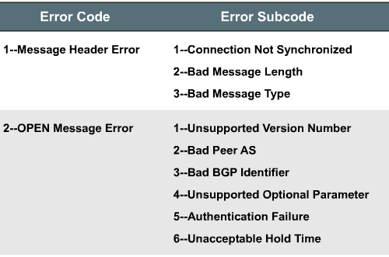
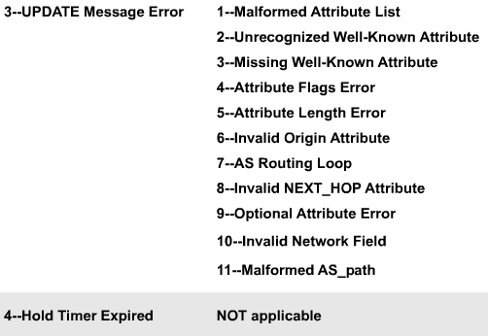
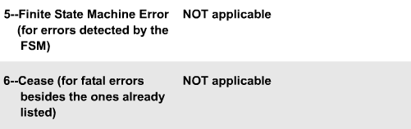
Notification Message
Sample error codes and their associated subcodes.

Slide 12
Keepalive Message Type
Keepalive messages are sent between peers every 60 seconds (by default) to maintain connections.
The message consists of only a message header (19 bytes).
Hold time is three times the KEEPALIVE timer of 60 seconds.
If the periodic timer = 0, no keepalives are sent.
Recommended keepalive interval is one-third of the hold time interval.
Keepalive Message
Octets
16 | 2 | 1
Marker | Length | Type

Slide 13
BGP States
BGP is a state machine that takes a router through the following states with its neighbors:
Idle
Connect
Open sent
Open confirm
Established
The Idle state begins once the neighbor command is configured.

Slide 14
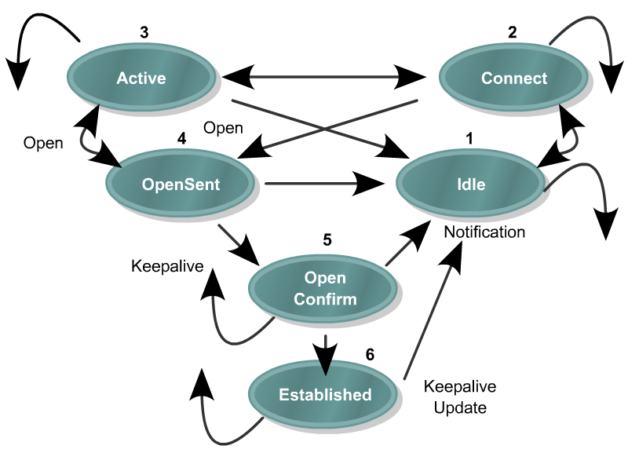
Idle State
Idle
The router is searching the routing table to see whether a route exists to reach the neighbor.
If a router remains in this state then the router is:
Waiting for a static route to that IP address or network to be configured.
Waiting for the IGP to learn about this network from another router.
Notes:
Check the following two conditions to troubleshoot this problem:
Ensure that the neighbor announces the route in its local routing protocol (IGP).
Verify that you have not entered an incorrect IP address in the neighbor statement.

Slide 15
Connect State
Connect
The router found a route to the neighbor and has completed the three-way TCP handshake.

Slide 16
Active State
Active
BGP is trying to acquire a peer by initiating a TCP connection.
If it is successful, it transitions to OpenSent otherwise the state returns to Idle.
If the router remains is this state it means that the router has not received a response (open confirm packet) back from the neighbor.
Reasons for this include missing neighbor statement or incorrect AS number.

Slide 17
Open Sent State
OpenSent
An open message was sent, with the parameters for the BGP session.

Slide 18
Open Confirm
Open
Confirm
The router received agreement on the parameters for establishing a session.

Slide 19
Established State
Established
This is the desired state for a neighbor relationship.
It means peering is established and routing begins.

Slide 20
Verifying BGP: show ip bgp neighbors
Verify the BGP neighbor relationship.
R1# show ip bgp neighbors
BGP neighbor is 172.31.1.3, remote AS 64998, external link
BGP version 4, remote router ID 172.31.2.3
BGP state = Established, up for 00:19:10
Last read 00:00:10, last write 00:00:10, hold time is 180, keepalive interval is 60 seconds
Neighbor capabilities:
Route refresh: advertised and received(old & new)
Address family IPv4 Unicast: advertised and received
Message statistics:
InQ depth is 0
OutQ depth is 0
Sent Rcvd
Opens: 7 7
Notifications: 0 0
Updates: 13 38
<output omitted>

Slide 21
Neighbor State Debug
RT1#debug ip bgp
BGP debugging is on
RT1#
00:00:55: BGP: 12.12.12.2 went from Idle to Active
00:00:55: BGP: 12.12.12.2 open active, delay 26011ms
00:01:11: BGP: 12.12.12.2 passive open
00:01:11: BGP: 12.12.12.2 went from Active to Idle
00:01:11: BGP: 12.12.12.2 went from Idle to Connect
00:01:11: BGP: 12.12.12.2 rcv message type 1, length (excl. header) 26
00:01:11: BGP: 12.12.12.2 rcv OPEN, version 4
00:01:11: BGP: 12.12.12.2 went from Connect to OpenSent
00:01:11: BGP: 12.12.12.2 sending OPEN, version 4, my as: 65001
00:01:11: BGP: 12.12.12.2 went from OpenSent to OpenConfirm
00:01:11: BGP: 12.12.12.2 send message type 1, length (incl. header) 45
00:01:11: BGP: 12.12.12.2 went from OpenConfirm to Established
00:01:11: %BGP-5-ADJCHANGE: neighbor 12.12.12.2 Up
Notes:
First part failed to establish neighbor

Slide 22
Path Attributes
Path attributes are a set of BGP metrics describing the path to a network (route).
BGP uses the path attributes to determine the best path to the networks.
Some attributes are mandatory and automatically included in update messages while others are manually configurable.
BGP attributes can be used to enforce a routing policy.
Configuring BGP attributes provides administrators with many more path control options.
E.g., filter routing information, prefer certain paths, customize BGP’s behavior.

Slide 23
Path Attributes
A BGP update message includes a variable-length sequence of path attributes describing the route.
A path attribute consists of three fields:
Attribute type
Attribute length
Attribute value
BGP Attribute Type
Type code 1 ORIGIN
Type code 2 AS_PATH
Type code 3 NEXT_HOP
Type code 4 MULTI_EXIT_DISC
Type code 5 LOCAL_PREF
Type code 6 ATOMIC_AGGREGATE
Type code 7 AGGREGATOR
Type code 8 Community (Cisco-defined)
Type code 9 Originator-ID (Cisco-defined)
Type code 10 Cluster list (Cisco-defined)
Path Attributes Information
Update Message
Octets
16 | 2 | 1 | 2 | Variable | 2 | Variable | Variable
Marker | Length | Type | Unfeasible Routes Length | Withdrawn Routes | Attribute Length | Path Attributes | NLRI
Notes:
The path attibute Length is a 2-octet unsigned integer indicates the total length of the Path Attributes field in octets.
Its value must allow the length of the Network Layer Reachability field to be determined as specified below.
A value of 0 indicates that no Network Layer Reachability Information field is present in this UPDATE message.
The first bit of the Path Attributes flags field indicates whether the attribute is optional or well known.
The second bit indicates whether an optional attribute is transitive or nontransitive.
The third bit indicates whether a transitive attribute is partial or complete.
The fourth bit indicates whether the attribute length field is 1 or 2 bytes.
The rest of the flag bits are unused and are set to 0.

Slide 24
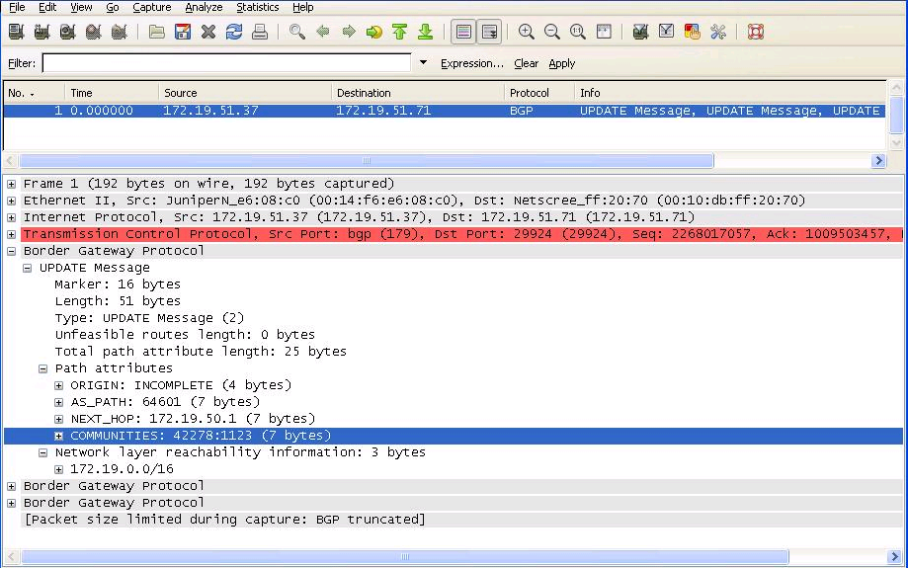
Path Attributes Within Update Message
Wireshark capture of an update message indicating the path attributes to reach network 172.19.0.0/16.
Notes:
Wireshark capture of a BGP update message.

Slide 25
Attributes
Some attributes are mandatory and automatically included in update messages while others are manually configurable.
Attribute | EBGP | IBGP
AS_PATH | Well-known Mandatory | Well-known Mandatory
NEXT_HOP | Well-known Mandatory | Well-known Mandatory
ORIGIN | Well-known Mandatory | Well-known Mandatory
LOCAL_PREF | Not allowed | Well-known Discretionary
ATOMIC_AGGREGATE | Well-known Discretionary | Well-known Discretionary
AGGREGATOR | Optional Transitive | Optional Transitive
COMMUNITY | Optional Transitive | Optional Transitive
MULTI_EXIT_DISC | Optional Nontransitive | Optional Nontransitive
Automatically included in update message
Can be configured to help provide path control.

Slide 26
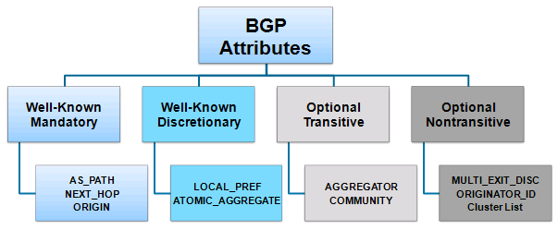
Path Attributes
There are four different attribute types.
Not all vendors recognize the same BGP attributes.

Slide 27
Well-Known Mandatory
Attribute is recognized by all implementations of BGP and must appear in a BGP update message.
If missing, a notification error will be generated.
Well-known mandatory attributes ensures that all BGP implementations agree on a standard set of attributes.

Slide 28
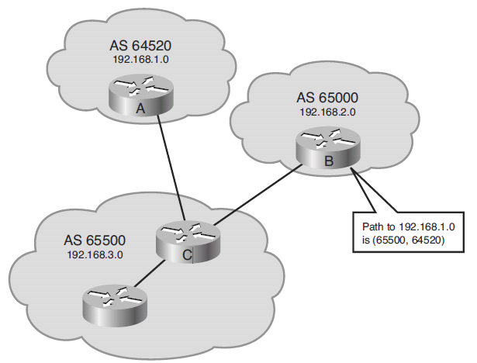
Well-Known Mandatory: AS_PATH
The AS_PATH attribute contains a list of AS numbers to reach a route.
Whenever a route update passes through an AS, the AS number is added to the beginning of the AS_PATH attribute before it is advertised to the next EBGP neighbor.

Slide 29
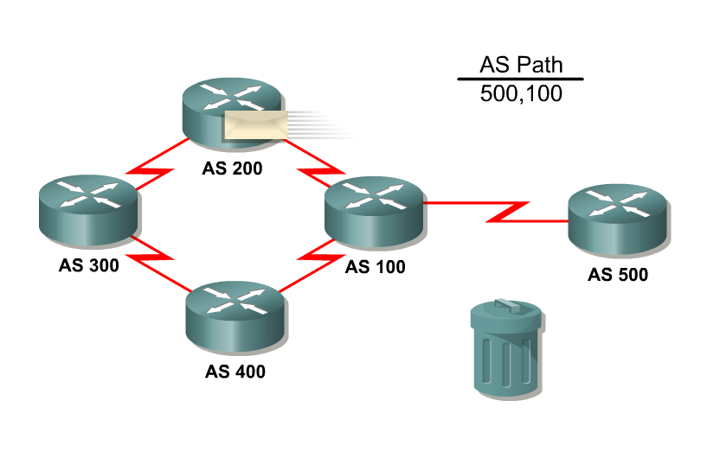
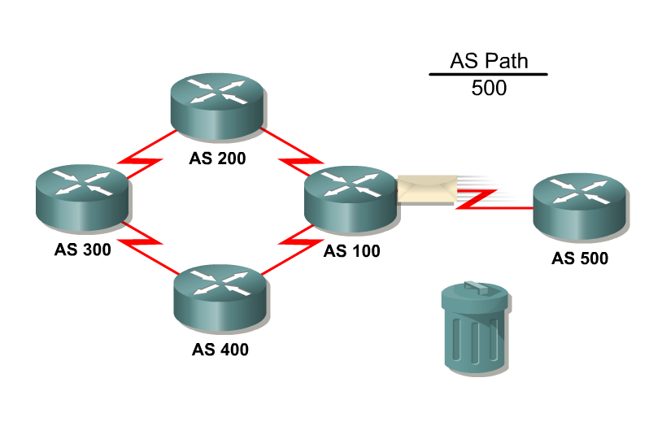
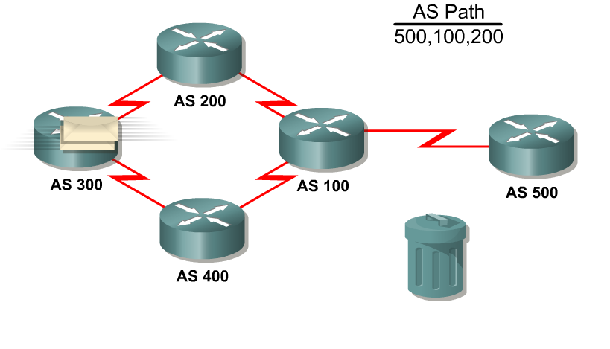
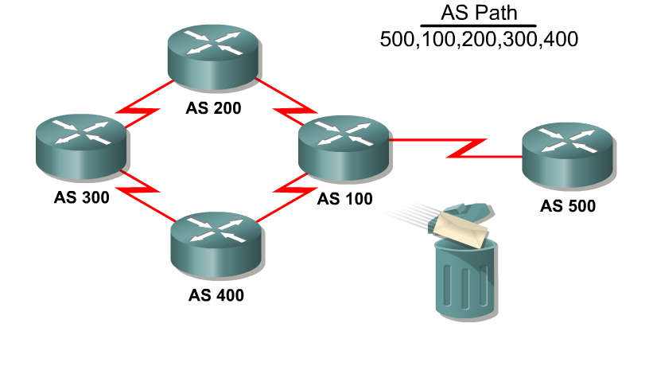
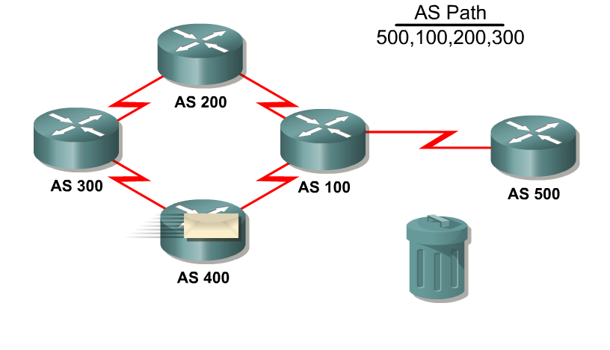
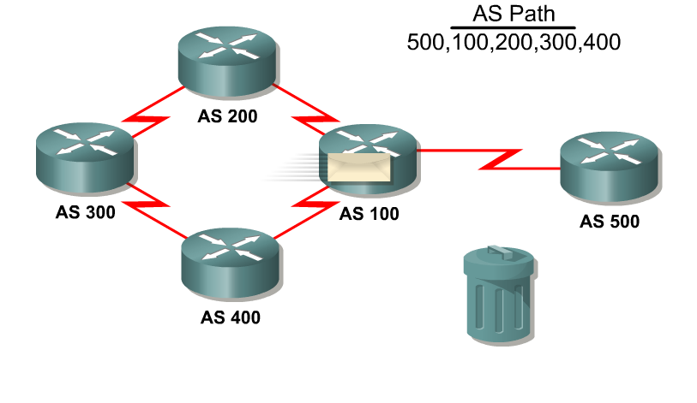
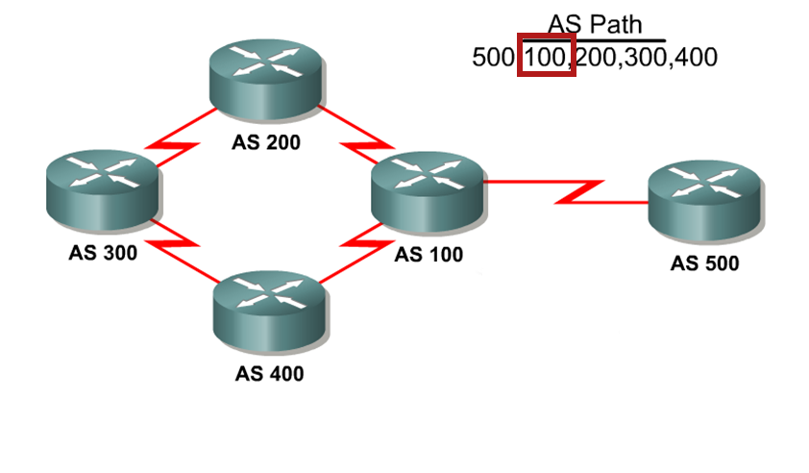
Well-Known Mandatory: AS_PATH
BGP always includes the AS_PATH attribute in its update.

Slide 30
Well-Known Mandatory: NEXT_HOP
The NEXT_HOP attribute indicates the IP address that is to be used to reach a destination.
The IP address is the entry point of the next AS along the path to that destination network.
Therefore, for EBGP, the next-hop address is the IP address of the neighbor that sent the update.

Slide 31
Well-Known Mandatory: ORIGIN
The ORIGIN attribute defines the origin of the path which could be:
IGP:
The route is interior to the originating AS and normally occurs when a network command is used to advertise the route via BGP.
An origin of IGP is indicated with an “i” in the BGP table.
EGP:
(Obsolete) The route is learned via EGP which is considered a historic routing protocol and is not supported on the Internet.
An origin of EGP is indicated with an “e” in the BGP table.
Incomplete:
The route’s origin is unknown or is learned via some other means and usually occurs when a route is redistributed into BGP.
An incomplete origin is indicated with a “?” in the BGP table.

Slide 32
Well-Known Mandatory: ORIGIN
i = Route generated by the network command.
R1# show ip bgp
BGP table version is 24, local router ID is 172.16.1.2
Status codes: s suppressed, d damped, h history, * valid, > best, i - internal
Origin codes: i - IGP, e - EGP, ? - incomplete
Network Next Hop Metric LocPrf Weight Path
*> 192.208.10.0 192.208.10.5 0 0 300 i
*> 172.16.1.0 0.0.0.0 0 32768 i
<output omitted>
R1# show ip bgp
<output omitted>
Network Next Hop Metric LocPrf Weight Path
*> 10.1.1.0/24 0.0.0.0 0 32768 ?
*> 192.168.1.0/24 10.1.1.2 84 32768 ?
*> 192.168.2.0/24 10.1.1.2 74 32768 ?
<output omitted>
? = Route generated by unknown method (usually redistributed).

Slide 33
Well-Known Discretionary
Attribute is recognized by all implementations of BGP but may not be sent in the BGP update message.

Slide 34
Well-Known Discretionary: LOCAL_PREF
The Local Preference attribute provides an indication to the “local” routers in the AS about which path is preferred to exit the AS.
A path with a higher local preference is preferred.
The default value for local preference on a Cisco router is 100.
It is configured on a router and exchanged between IBGP routers.
It is not passed to EBGP peers.

Slide 35
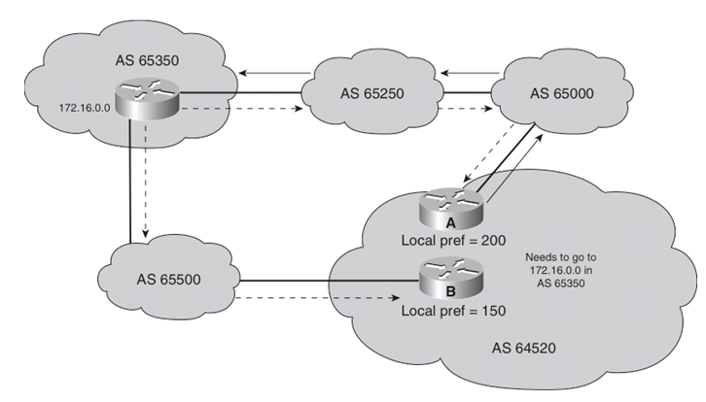
Well-Known Discretionary: LOCAL_PREF
Routers A and B are IBGP neighbors in AS 64520 and both receive updates about network 172.16.0.0 from different directions.
The local preference on router A is set to 200.
The local preference on router B is set to 150.
Because the local preference for router A is higher, it is selected as the preferred exit point from AS 64520.

Slide 36
Configuring the Default Local Preference
The bgp default local-preference command changes the default local preference value.
With this command, all IBGP routes that are advertised have the local preference set to the value specified.
If an EBGP neighbor receives a local preference value, the EBGP neighbor ignores it.

Slide 37
Well-Known Discretionary: ATOMIC_AGGREGATE
The Atomic Aggregate attribute is used to indicate that routes have been summarized.
Attribute warns that the received information may not necessarily be the most complete route information available.
Attribute is set to either True or False with “true” alerting other BGP routers that multiple destinations have been grouped into a single update.
Router update includes its router ID and AS number along with the supernet route enabling administrators to determine which BGP router is responsible for a particular instance of aggregation.
Tracing a supernet to its original "aggregator" may be necessary for troubleshooting purposes.
Notes:
Covered in detail later

Slide 38
Optional Transitive
Attribute may or may not be recognized by all BGP implementations.
Because the attribute is transitive, BGP accepts and advertises the attribute even if it is not recognized.

Slide 39
Optional Transitive: Community
The BGP community attribute can be used to filter incoming or outgoing routes.
BGP routers can tag routes with an indicator (the community) and allow other routers to make decisions based on that tag.
If a router does not understand the concept of communities, it defers to the next router.
However, if the router does understand the concept, it must be configured to propagate the community; otherwise, communities are dropped by default.
Communities are not restricted to one network or one AS, and they have no physical boundaries.
Notes:
Community = tag

Slide 40
Optional Nontransitive
Attribute that may or may not be recognized by all BGP implementations.
Whether or not the receiving BGP router recognizes the attribute, it is nontransitive and is not passed along to other BGP peers.

Slide 41
Optional Nontransitive: MED
The Multiple Exit Discriminator (MED) attribute, also called the metric, provides a hint to external neighbors about the preferred path into an AS that has multiple entry points.
Lower MED is preferred over a higher MED!
The MED is sent to EBGP peers and those routers propagate the MED within their AS.
The routers within the AS use the MED, but do not pass it on to the next AS.
When the same update is passed on to another AS, the metric will be set back to the default of 0.
By using the MED attribute, BGP is the only protocol that can affect how routes are sent into an AS.
Notes:
Note:
MED influences inbound traffic to an AS.
Local preference influences outbound traffic from an AS.
Note:
By default, the MED comparison is done only if the neighboring AS is the same for all routes considered.
For the router to compare metrics from neighbors coming from different autonomous systems, the bgp always-compare-med router configuration command must be configured on the router.

Slide 42
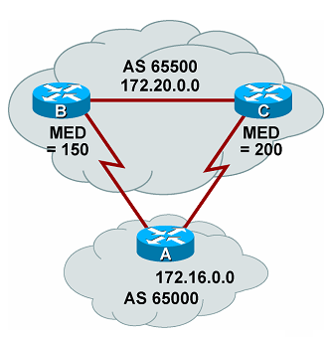
Optional Nontransitive: MED
Routers B and C include a MED attribute in the updates to router A.
Router B MED attribute is set to 150.
Router C MED attribute is set to 200.
When A receives updates from B and C, it picks router B as the best next hop because of the lower MED.

Slide 43
Cisco Weight Attribute
The Weight attribute is a Cisco proprietary attribute.
Similar in function to the local preference, the weight attribute applies when 1 router has multiple exit points.
Local preference is used when 2+ routers provide multiple exit points.
It is configured locally on a router and is not propagated to any other routers.
Routes with a higher weight are preferred when multiple routes exist to the same destination.
The weight can have a value from 0 to 65535.
Paths that the router originates have a weight of 32768 by default, and other paths have a weight of 0 by default.

Slide 44
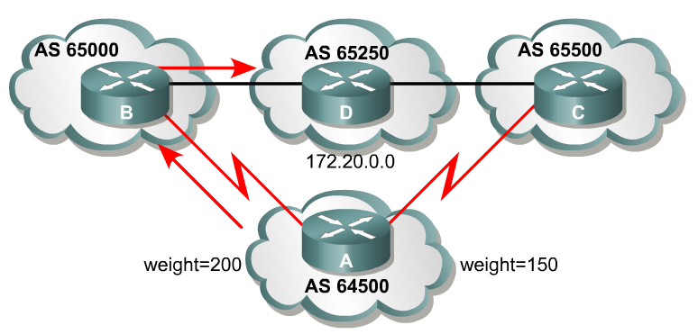
Cisco Weight Attribute
Routers B and C learn about network 172.20.0.0 from AS 65250 and propagate the update to router A.
Therefore Router A has two ways to reach 172.20.0.0.
Router A sets the weight of updates as follows:
Updates coming from router B are set to 200
Updates coming from router C are set to 150.
Router A uses router B because of the higher weight.

Slide 45
BGP Route Selection Process
The BGP best path decision is based on the value of attributes that the update contains and other BGP-configurable factors.
BGP considers only synchronized routes with no AS loops and a valid next-hop address.

Slide 46
BGP Route Selection Process
Prefer the route with highest weight.
Prefer the route with the lowest MED.
Prefer the EBGP route over IBGP route.
Prefer the route with highest LOCAL_PREF.
Prefer the route through the closest IGP neighbor.
Prefer the locally generated route (network or aggregate routes).
Prefer the oldest EBGP route.
Prefer the route with the shortest AS-PATH.
Prefer the route with the lowest neighbor BGP router ID value.
Prefer the route with the lowest ORIGIN (IGP<EGP<incomplete)
Prefer the route with the lowest neighbor IP address.
Notes:
The Highest Weight path is preferred. Weight is a Cisco proprietary parameter.
Prefer the route with the Highest Local Preference.
Prefer the route that was Locally Originated (originated by this router).
Prefer the route with the Shortest AS_path.
Prefer the route with the Lowest Origin Type. IGP < EGP < Incomplete.
Prefer the route with the Lowest MED.
Prefer the EBGP routes over IBGP.
If all the preceding scenarios are identical, prefer the route that can be reached via the closest IGP neighbor.
If the internal path is the same, the BGP router ID will be a tie breaker.
Prefer the route with the lowest router ID.
Router ID is the highest loopback address or highest IP address

Slide 47
BGP & the route table
Using the best path selection algorithm, the single best route is eligible to be propagated into the route table
If the administrative distance is lower and the prefix length is longer than routes learned via other means it will be installed into the route table
Can be changed with eBGP / iBGP multipath
Multipath will allow installation into the IP routing table of multiple BGP paths to the same destination. Weight, Local Pref, AS path length, Origin & MED must be equal

Slide 48
Administrative Distance
Default values
eBGP routes have an administrative distance of 20
iBGP routes have an administrative distance of 200
Junos – iBGP & eBGP preference = 170

Slide 49
What routes are advertised
By default BGP advertises the best route only to its peers
only advertise * > routes (valid / reachable, best path)
Even if multipath is configured only the single best route is advertised to peers
If route is not Valid or Reachable – Route is stored in local BGP table but not advertised and not put in local Route table

Slide 50
Verifying BGP: show ip bgp
Display the BGP topology database (the BGP table).
The status codes are shown in the first column of each line of output.
* means that the next-hop address (in the fifth column) is valid.
r means a RIB failure and the route was not installed in the RIB.
R1# show ip bgp
BGP table version is 14, local router ID is 172.31.11.1
Status codes: s suppressed, d damped, h history, * valid, > best, i - internal, r RIB-failure, S Stale
Origin codes: i - IGP, e - EGP, ? - incomplete
Network Next Hop Metric LocPrf Weight Path
*> 10.1.0.0/24 0.0.0.0 0 32768 i
* i 10.1.0.2 0 100 0 i
*> 10.1.1.0/24 0.0.0.0 0 32768 i
*>i10.1.2.0/24 10.1.0.2 0 100 0 i
*> 10.97.97.0/24 172.31.1.3 0 64998 64997 i
* 172.31.11.4 0 64999 64997 i
* i 172.31.11.4 0 100 0 64999 64997 i
*> 10.254.0.0/24 172.31.1.3 0 0 64998 i
* 172.31.11.4 0 64999 64998 i
* i 172.31.1.3 0 100 0 64998 i
r> 172.31.1.0/24 172.31.1.3 0 0 64998 i
r 172.31.11.4 0 64999 64998 i
r i 172.31.1.3 0 100 0 64998 i
*> 172.31.2.0/24 172.31.1.3 0 0 64998 i
A > in the second column indicates the best path for a route selected by BGP.
This route is offered to the IP routing table.
The third column is either blank or has an “i” in it.
- If it has an i, an IBGP neighbor advertised this route to this router.
- If it is blank, BGP learned that route from an external peer.
This section lists three BGP path attributes: metric (MED), local preference, and weight.
The Path section lists the AS path. The last AS # is the originating AS.
If blank the route is from the current autonomous system.
The last column displays the ORIGIN attribute).
- i means the original router probably used a network command to introduce this network into BGP.
- ? means the route was probably redistributed from an IGP into the BGP process.
Notes:
Other first column options:
An s indicates that the specified routes are suppressed (usually because routes have been summarized and only the summarized route is being sent).
A d, for dampening, indicates that the route is being dampened (penalized) for going up and down too often. Although the route might be up right now, it is not advertised until the penalty has expired.
An h, for history, indicates that the route is unavailable and is probably down. Historic information about the route exists, but a best route does not exist.
An r, for RIB failure, indicates that the route was not installed in the RIB. The reason that the route is not installed can be displayed using the show ip bgp rib-failure command.
An S, for stale, indicates that the route is stale. (This is used in a nonstop forwarding aware router.)

